Slide 1
Big Data Analytics (2CS702)
Lecture #1
Introduction to Big Data
Dr Jai Prakash Verma
Associate Professor
Department of Computer Science & Engineering
Institute of Technology, Nirma University, Ahmedabad

Slide 2
In today’s discussion…
Introduction to data
Current trend
Data and Big data
Big data vs. small data
Tools and techniques

Slide 3
Introduction to data
Example:
10, 25, …, Kharagpur, 10CS3002, namo@gov.in
Anything else?
Data vs. Information
100.0, 0.0, 250.0, 150.0, 220.0, 300.0, 110.0
Is there any information?

Slide 4
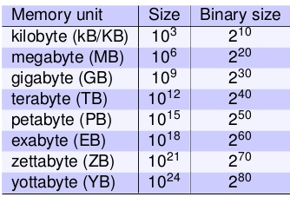
How large your data is?
What is the maximum file size you have dealt so far?
Movies/files/streaming video that you have used?
What is the maximum download speed you get?
To retrieve data stored in distant locations?
How fast your computation is?
How much time to just transfer from you, process and get result?

Slide 5
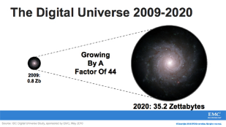

Growth of data

Slide 6
Sources of data
“Every day, we create 2.5 quintillion bytes of data
So much that 90% of the data in the world today has been created in the last two years alone.
The data come from several sources
sensors used to gather climate information
posts to social media sites,
digital pictures and videos
purchase transaction records
cell phone GPS signals
etc. …… to name a few!

Slide 7

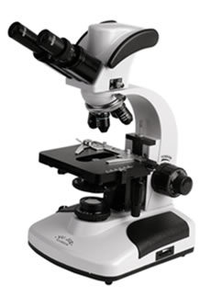

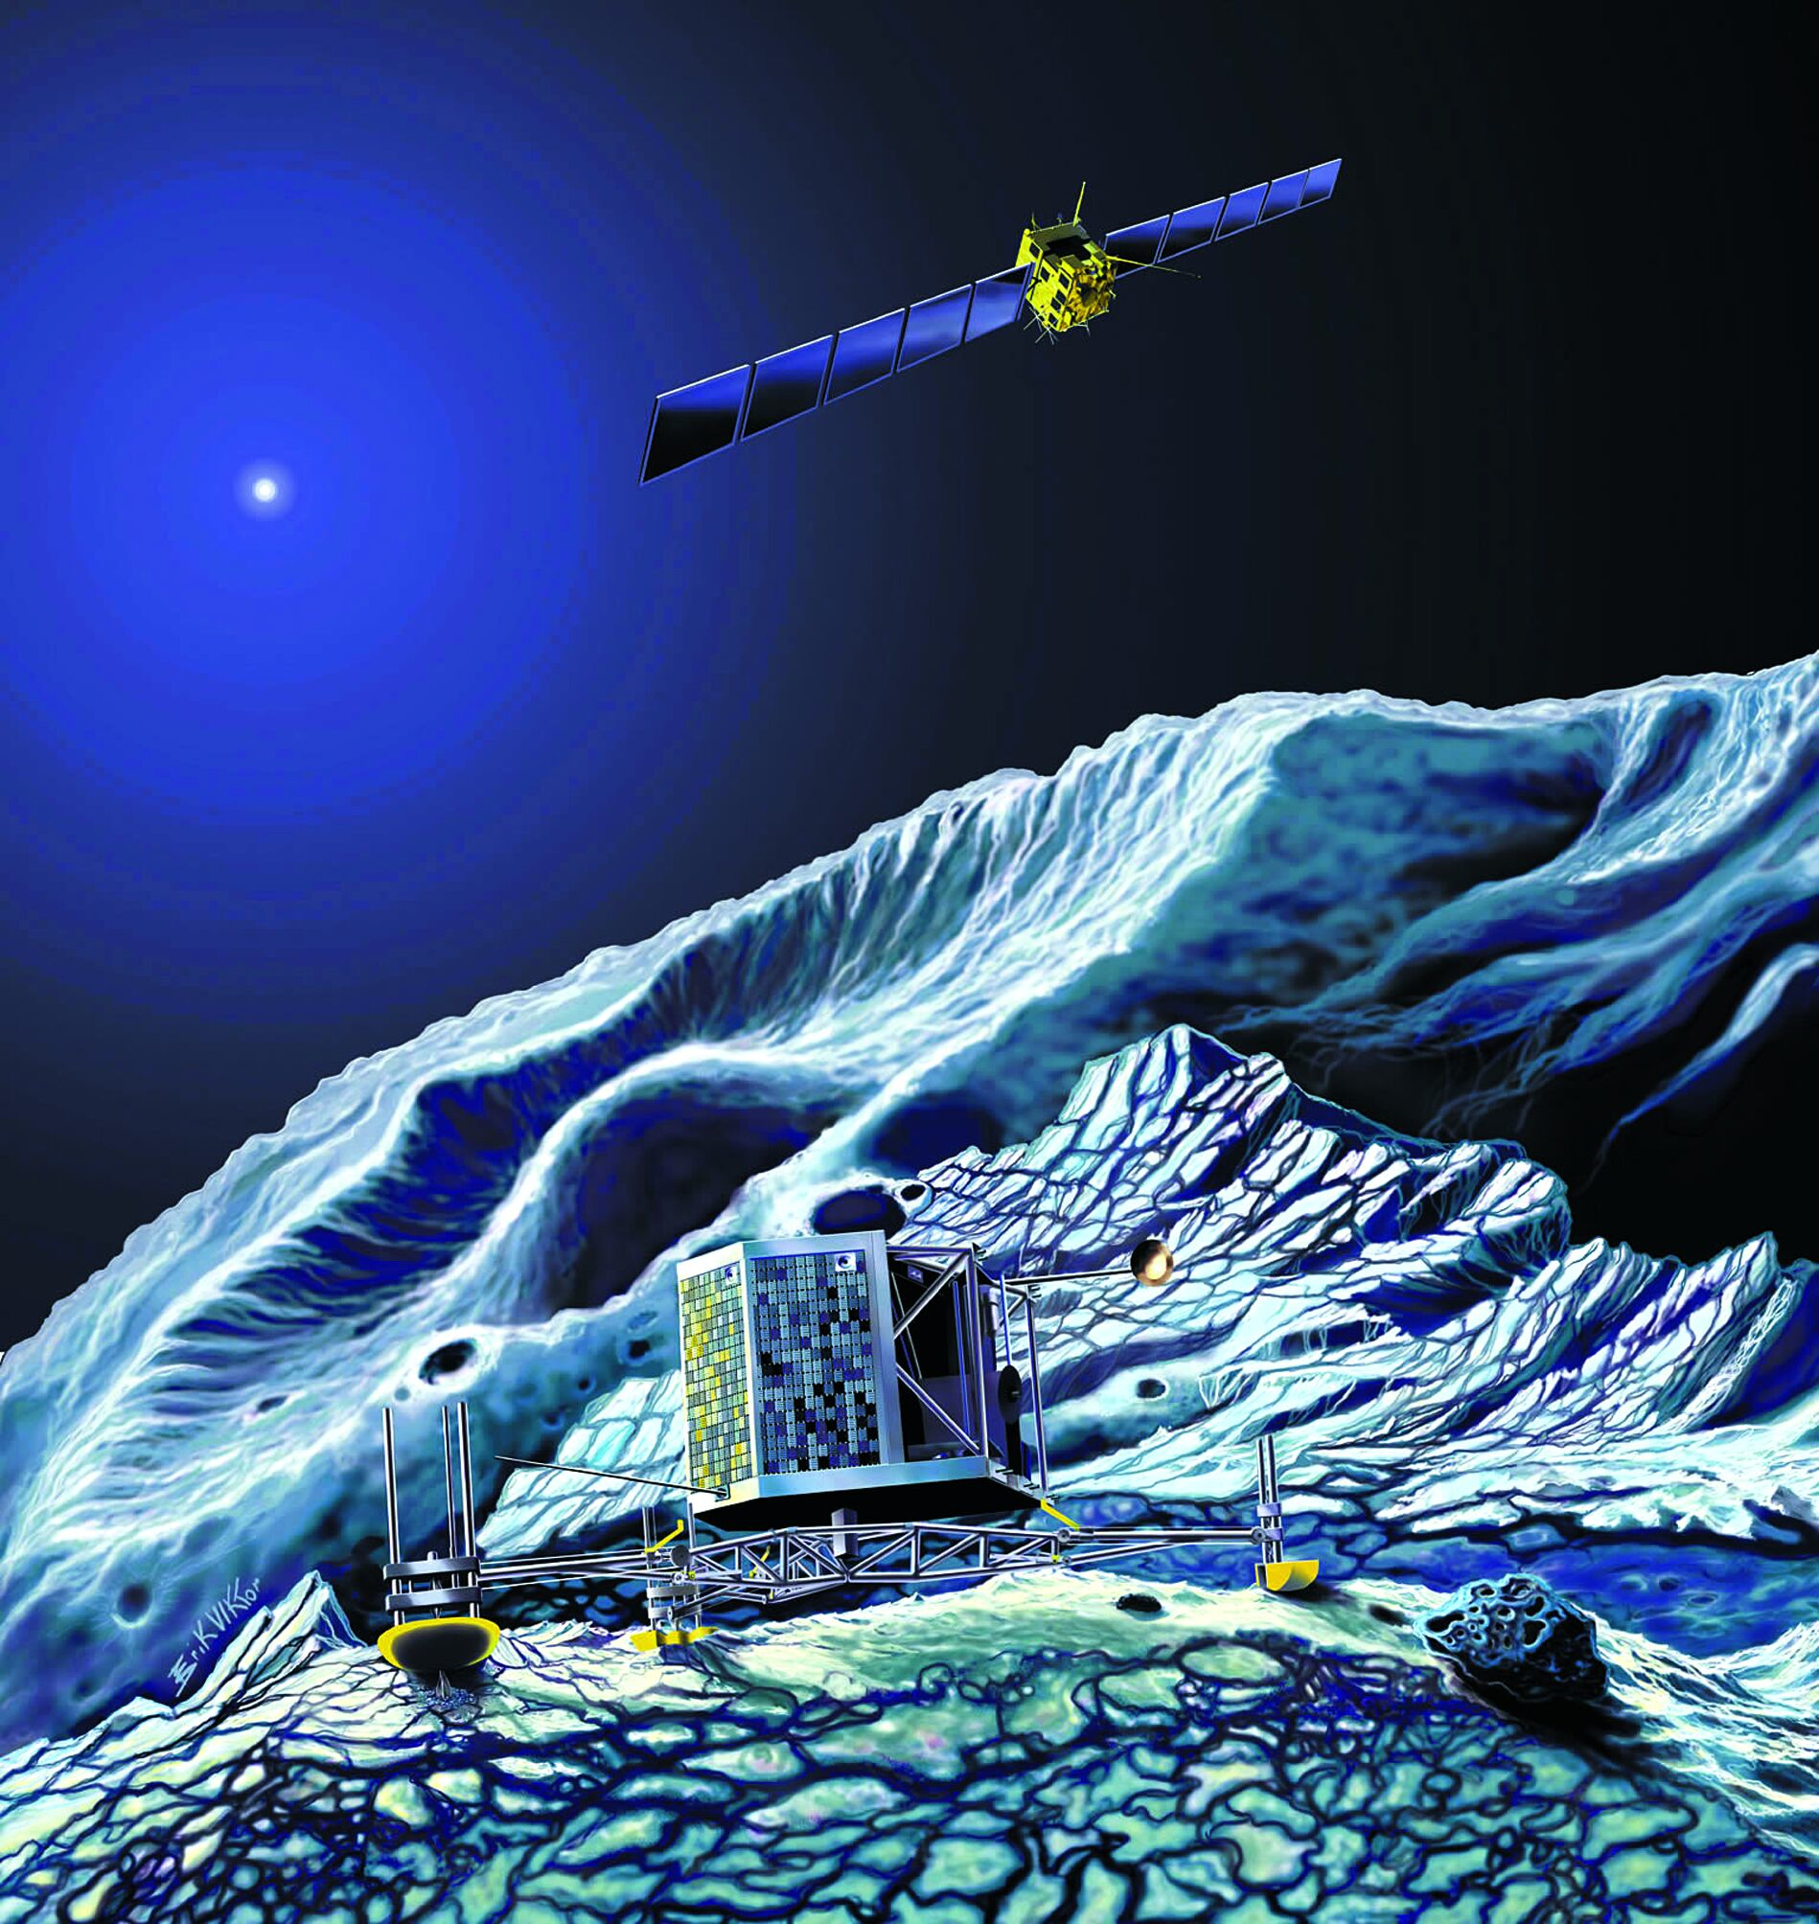
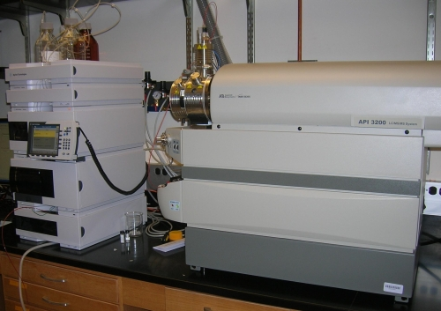
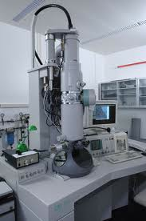

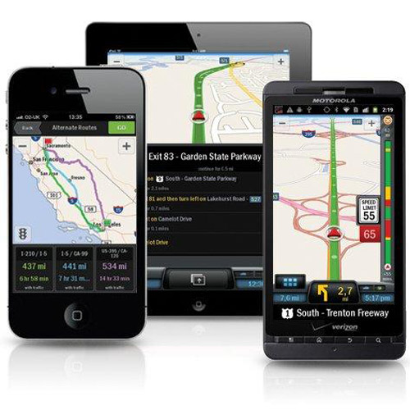
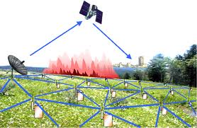
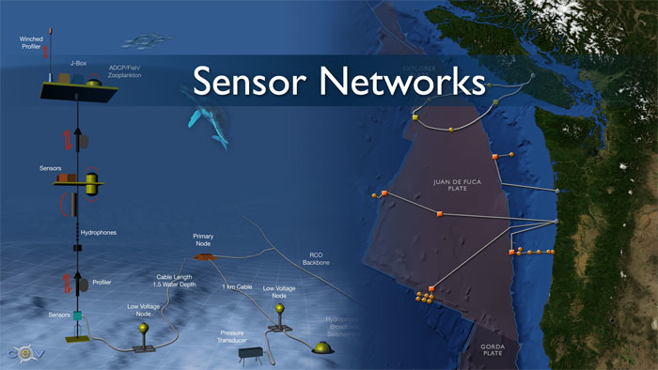
Examples
Social media and networks
(All of us are generating data)
Scientific instruments
(Collecting all sorts of data)
Sensor technology and networks
(Measuring all kinds of data)
Mobile devices
(Tracking all objects all the time)

Slide 8
Now data is Big data!
No single standard definition!
‘Big-data’ is similar to ‘Small-data’, but bigger
…but having data bigger consequently requires different approaches
techniques, tools and architectures
…to solve: new problems
…and, of course, in a better way
Big data is data whose scale, diversity, and complexity require new architecture, techniques, algorithms, and analytics to manage it and extract value and hidden knowledge from it…

Slide 9
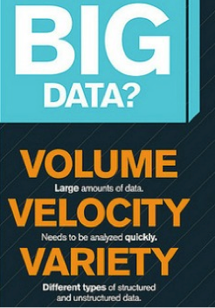
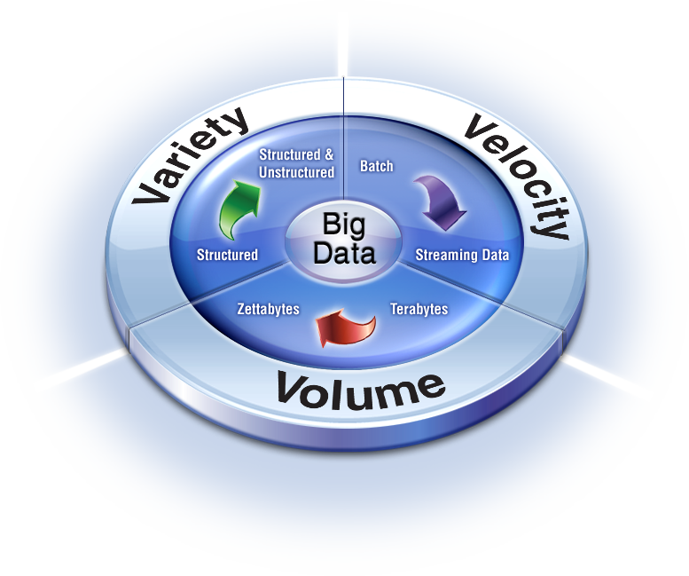
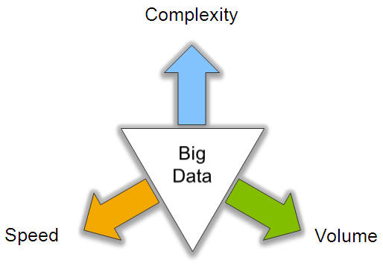
Characteristics of Big data: V3

Slide 10
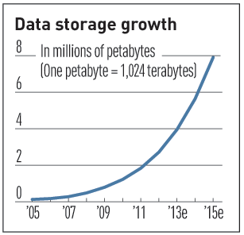
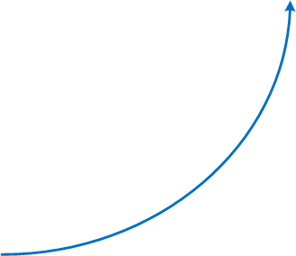
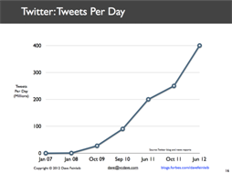
V3 : V for Volume
Volume of data, which needs to be processed is increasing rapidly
More storage capacity
More computation
More tools and techniques

Slide 11
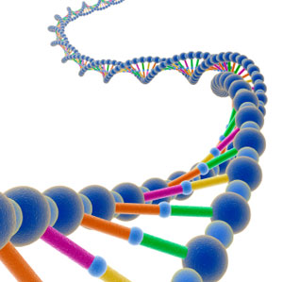
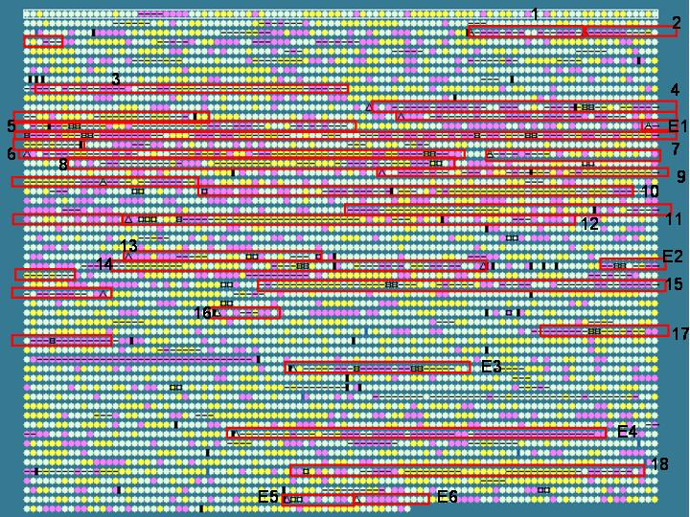
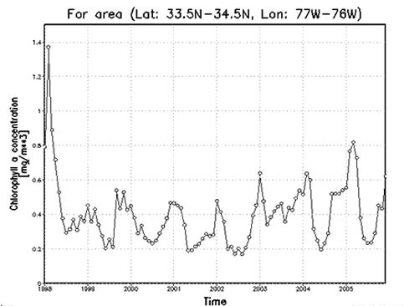
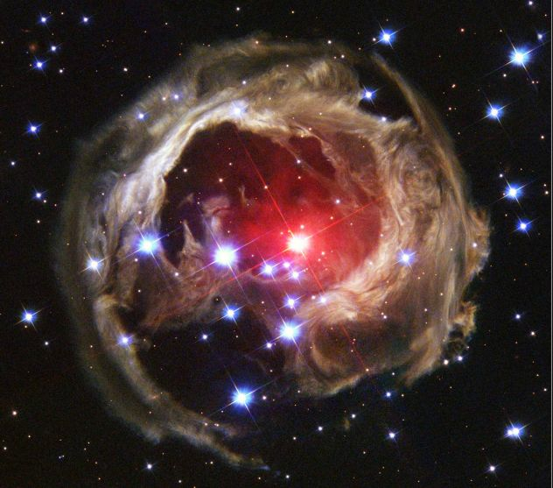

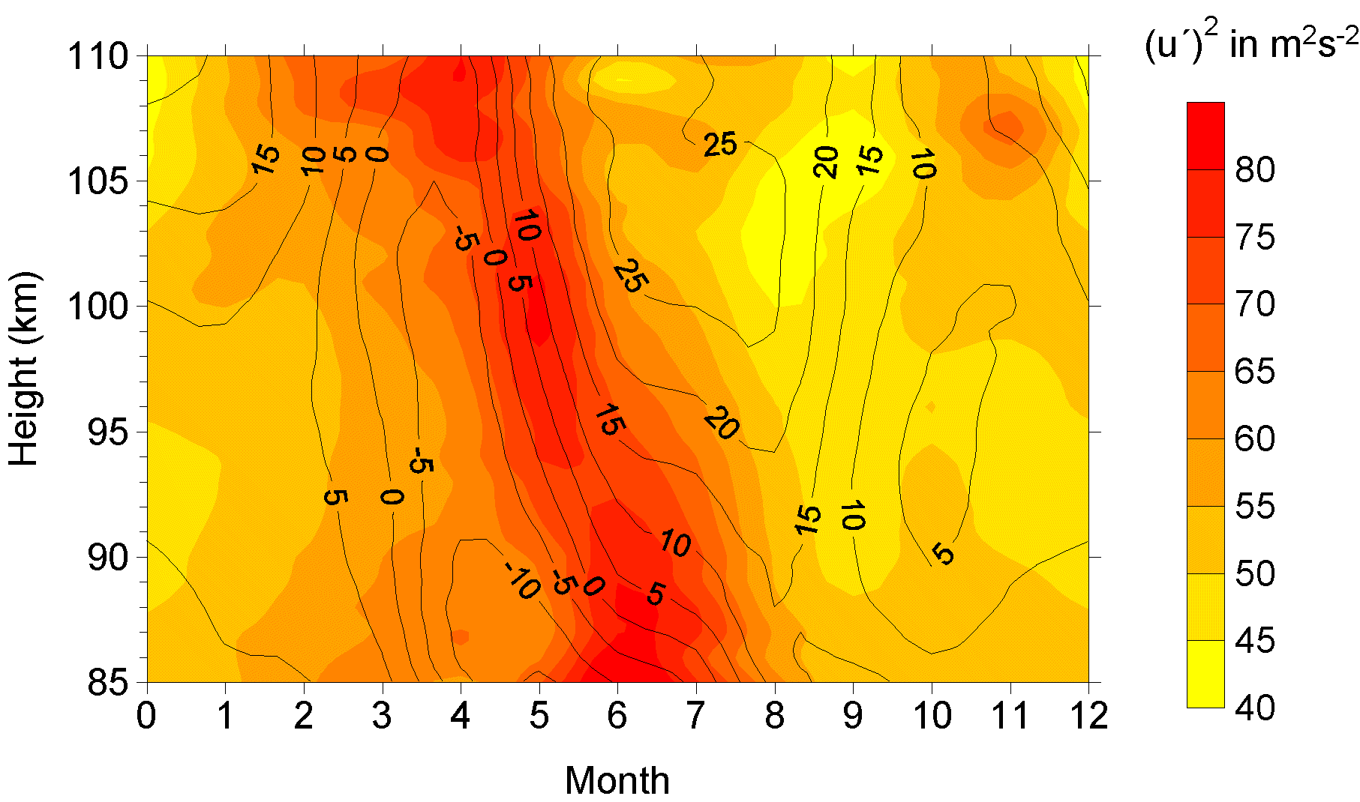
V3: V for Variety
Various formats, types, and structures
Text, numerical, images, audio, video, sequences, time series, social media data, multi-dimensional arrays, etc…
Static data vs. streaming data
A single application can be generating/collecting many types of data
To extract knowledge➔ all these types of data need to be linked together

Slide 12

V3: V for Velocity
Data is being generated fast and need to be processed fast
For time-sensitive processes such as catching fraud, big data must be used as it streams into your enterprise in order to maximize its value
Scrutinize 5 million trade events created each day to identify potential fraud
Analyze 500 million daily call detail records in real-time to predict customer churn faster
Sometimes, 2 minutes is too late!
The latest we have heard is 10 ns (nano seconds) delay is too much

Slide 13
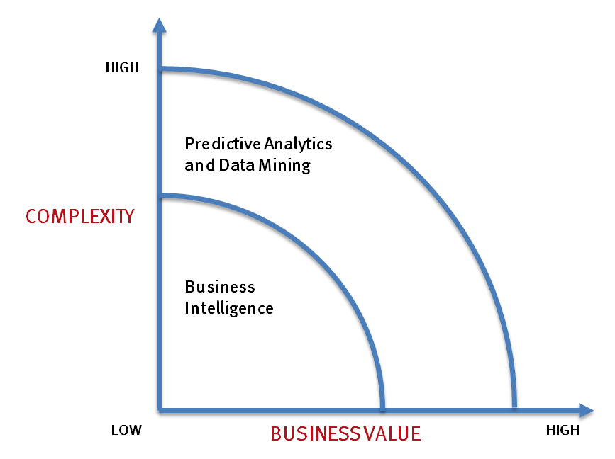
Big data vs. small data
- Optimizations and predictive analytics
- Complex statistical analysis
- All types of data, and many sources
- Very large datasets
- More of a real-time
- Ad-hoc querying and reporting
- Data mining techniques
- Structured data, typical sources
- Small to mid-size datasets

Slide 14
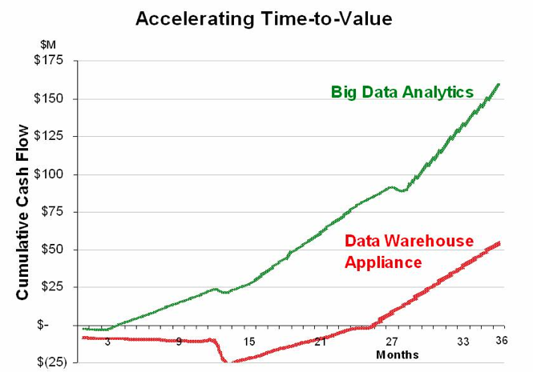
Big data vs. small data
Big data is more real-time in nature than traditional applications
Big data architecture
Traditional architectures are not well-suited for big data applications (e.g. Exa-data, Tera-data)
Massively parallel processing, scale out architectures are well-suited for big data applications

Slide 15
Challenges ahead…
The Bottleneck is in technology
New architecture, algorithms, techniques are needed
Also in technical skills
Experts in using the new technology and dealing with Big data
Who are the major players in the world of Big data?

Slide 16
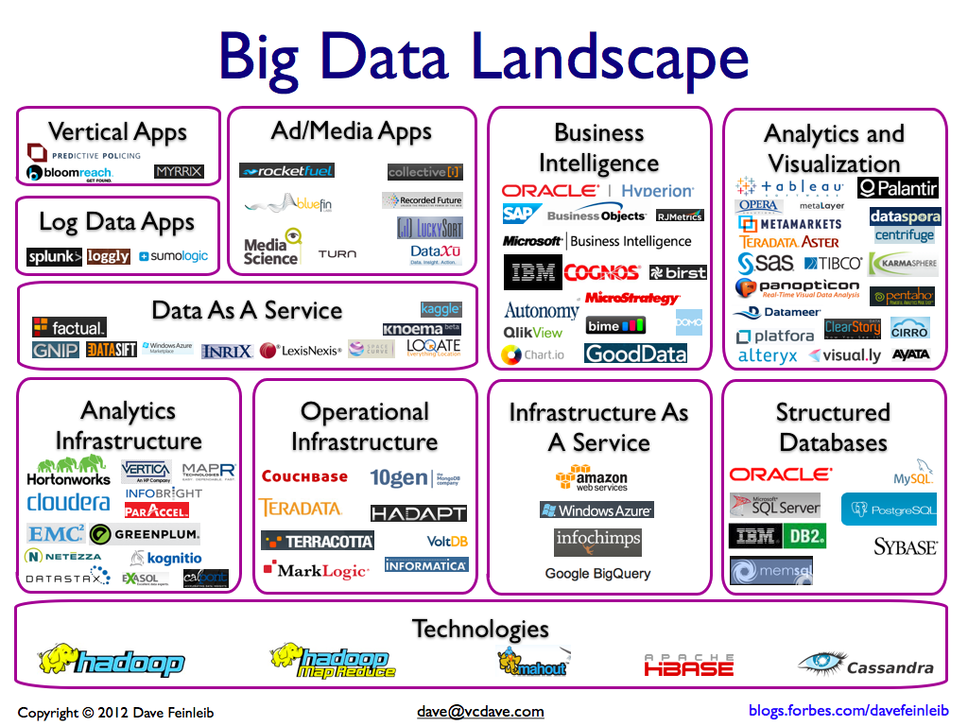
Big data players

Slide 17






Major players…
Google
Hadoop
MapReduce
Mahout
Apache Hbase
Cassandra

Slide 18
Tools available
NoSQL
DatabasesMongoDB, CouchDB, Cassandra, Redis, BigTable, Hbase, Hypertable, Voldemort, Riak, ZooKeeper
MapReduce
Hadoop, Hive, Pig, Cascading, Cascalog, mrjob, Caffeine, S4, MapR, Acunu, Flume, Kafka, Azkaban, Oozie, Greenplum
Storage
S3, HDFS, GDFS
Servers
EC2, Google App Engine, Elastic, Beanstalk, Heroku
Processing
R, Yahoo! Pipes, Mechanical Turk, Solr/Lucene, ElasticSearch, Datameer, BigSheets, Tinkerpop

Slide 19
Any question?

Slide 20
Questions of the day…
What is the smallest and largest units of measuring size of data?
How big a Quintillion measure is?
Give the examples of a smallest the largest entities of data.
Give FIVE parameters with which data can be categorized as i) simple, ii) Moderately complex and iii) complex?

Slide 21
Questions of the day…
What type of data are involved in the following applications?
Weather forecasting
Mobile usage of all customers of a service provider
Anomaly (e.g. fraud) detection in a bank organization
Person categorization, that is, identifying a human
Air traffic control in an airport
Streaming data from all flying aircrafts of Boeing

Slide 22
System/platform level requirements
How quickly do we need to get the results?
How big is the data to be processed?
Does the model building require several iterations or single iteration?
Will there be a need for more data processing capability in the future?
Is the rate of data transfer critical for this application?
Is there a need for handling hardware failures within the application?

Slide 23
Horizontal Scaling
It involves distributing the workload across many servers which may be even commodity machines.
It is also known as “scale out”, where multiple independent machines are added together in order to improve the processing capability.
Typically, multiple instances of the operating system are running on separate machines.

Slide 24
Vertical Scaling
Vertical Scaling involves installing more processors, more memory and faster hardware, typically, within a single server.
It is also known as “scale up” and it usually involves a single instance of an operating system.

Slide 25
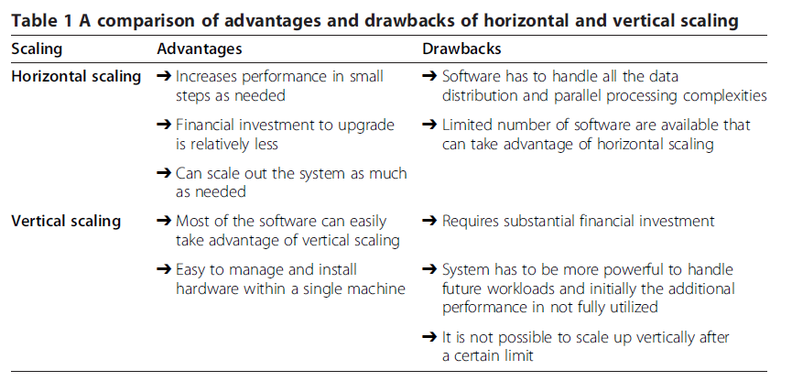

Slide 26
Horizontal Scaling Platforms
Peer-to-Peer Network
Apache Hadoop
Apache Spark
Vertical Scaling Platforms
High performance computing clusters
Multicore CPU
Graphics Processing Unit(GPU)
Field Programmable gate arrays(FPGA)

Slide 27
Peer-to-Peer networks
involve millions of machines connected in a network
decentralized and distributed network architecture where the nodes in the networks (known as peers) serve as well as consume resources.
oldest distributed computing platforms
Message Passing Interface (MPI) for communication scheme used in such a setup to communicate and exchange the data between peers.
Each node can store the data instances and the scale out is practically unlimited (can be millions of nodes).

Slide 28
Apache Hadoop
open source framework for storing and processing large datasets using clusters of commodity hardware.
Hadoop is designed to scale up to hundreds
highly fault tolerant
The Hadoop platform contains the following two important components: (1) HDFS (2) YARN

Slide 29
Apache Spark
developed by researchers at the University of California at Berkeley. designed to overcome the disk I/O limitations
ability to perform in-memory computations.
allows the data to be cached in memory, thus eliminating the
Hadoop’s disk overhead limitation for iterative tasks.
supports Java, Scala and Python and for certain tasks
it is tested to be up to 100× faster than Hadoop MapReduce

Slide 30
HPC clusters
Known as blades or supercomputers, are machines with thousands of cores.
They can have a different variety of disk organization, cache, communication mechanism etc.
powerful hardware which is optimized for speed and throughput.
They are not as scalable as Hadoop or Spark clusters but they are still capable of processing terabytes of data.

Slide 31
Multicore CPU
Multicore refers to one machine having dozens of processing cores They usually have shared memory but only one disk.
the number of cores per chip and the number of operations that a core can perform has increased significantly. Newer breeds of motherboards allow multiple CPUs within a single machine thereby increasing the parallelism.
Until the last few years, CPUs were mainly responsible for accelerating the algorithms for big data analytics.

Slide 32
GPU
It is designed to accelerate the creation of images in a frame buffer intended for display output
GPUs were primarily used for graphical operations such as video and image editing, accelerating graphics-related processing etc. due to their massively parallel architecture, recent developments in GPU hardware and related programming frameworks have given rise to GPGPU
In addition to the processing cores, GPU has its own high throughput DDR5 memory which is many times faster than a typical DDR3 memory.

Slide 33
FPGA (Field Programmable gate arrays)
highly specialized hardware units for specific applications
FPGAs can be highly optimized for speed and can be orders of magnitude faster compared to other platforms for certain applications.
Due to customized hardware, the development cost is typically much higher compared to other platforms.
On the software side, coding has to be done in HDL with a low-level knowledge of the hardware which increases the algorithm development cost.

Slide 34
Comparison of platforms
System/Platform Level characteristics
Scalability
Data I/O performance
Fault Tolerance

Slide 35
Scalability
Platform | Scalability
Peer-to-Peer | * * * * *
Virtual Clusters(MapReduce/MPI) | * * * * *
Virtual Clusters(Spark) | * * * * *
HPC clusters (MPI/MapReduce) | * * *
Multicore(Multithreading) | * *
GPU(CUDA) | * *
FPGA(HDL) | *

Slide 36
Data I/O Performance
Platform | Data I/O performance
Peer-to-Peer | *
Virtual Clusters(MapReduce/MPI) | * *
Virtual Clusters(Spark) | * * *
HPC clusters (MPI/MapReduce) | * * * *
Multicore(Multithreading) | * * * *
GPU(CUDA) | * * * * *
FPGA(HDL) | * * * * *

Slide 37
Fault Tolerance
Platform | Fault Tolerance
Peer-to-Peer | *
Virtual Clusters(MapReduce/MPI) | * * * * *
Virtual Clusters(Spark) | * * * * *
HPC clusters (MPI/MapReduce) | * * * *
Multicore(Multithreading) | * * * *
GPU(CUDA) | * * * *
FPGA(HDL) | * * * *

Slide 38
Comparison of platforms
Application/Algorithm Level characteristics
Real time processing
Data size supported
Iterative task support

Slide 39
Real Time Processing
Platform | Real Time Processing
Peer-to-Peer | *
Virtual Clusters(MapReduce/MPI) | * *
Virtual Clusters(Spark) | * *
HPC clusters (MPI/MapReduce) | * * *
Multicore(Multithreading) | * * *
GPU(CUDA) | * * * * *
FPGA(HDL) | * * * * *

Slide 40
Data Size supported
Platform | Data Size supported
Peer-to-Peer | * * * * *
Virtual Clusters(MapReduce/MPI) | * * * *
Virtual Clusters(Spark) | * * * *
HPC clusters (MPI/MapReduce) | * * * *
Multicore(Multithreading) | * *
GPU(CUDA) | * *
FPGA(HDL) | * *

Slide 41
Iterative Task Support
Platform | Iterative task support
Peer-to-Peer | * *
Virtual Clusters(MapReduce/MPI) | * *
Virtual Clusters(Spark) | * * *
HPC clusters (MPI/MapReduce) | * * * *
Multicore(Multithreading) | * * * *
GPU(CUDA) | * * * *
FPGA(HDL) | * * * *

Slide 42
Thank You

